Slide 1
CSDR Submit-Review Website Submitter Guide
April 2017
CADE Support
(253)564-1979 Ex. 1
CADESupport@tecolote.com

Slide 2
CSDR-SR Submitter Guide
The following document provides step-by-step screenshots to illustrate the major actions performed by Submitters in the CSDR-SR system:
Obtaining an ECA Certificate
Requesting a CADE Portal Account
Logging into the Submit-Review Application
Requesting Contract Access
XML Conversion Instructions
Upload Home Overview
Submitting Cost Reports
Submitting Software Reports and CWBS Dictionaries
Viewing CSDR Plans

Slide 3
Obtaining an ECA Certificate

Slide 4
Obtaining an ECA Certificate
Before you will be able to request access to the CADE Portal you will first need to have a valid CAC or ECA Certificate
The type of ECA certificate required is a Medium Token Assurance Identity Certificate
To locate approved certificate vendors please visit the ECA PKI Program Website at: http://iase.disa.mil/pki/eca/Pages/index.aspx
The following companies have approved company-wide ECA certificates (users should contact their IT departments for more information): Boeing, Lockheed Martin Corporation, Booz Allen Hamilton, Northrop Grumman, and Raytheon

Slide 5
Requesting a CADE Portal Account

Slide 6
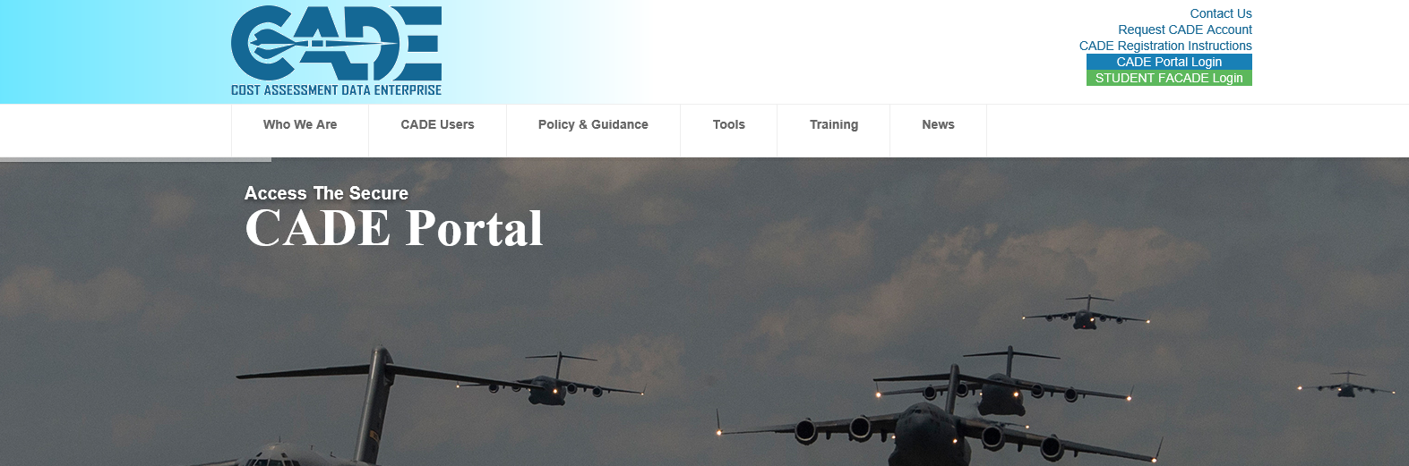
Requesting a CADE Portal Account
From the CADE Home page select the “Request CADE Account” link
http://cade.osd.mil/ To request a CADE Portal account, select the “Request CADE Account” link
If you already have a CADE Portal account, you do not need to register for a new account. Please contact CADESupport@tecolote.com for assistance

Slide 7
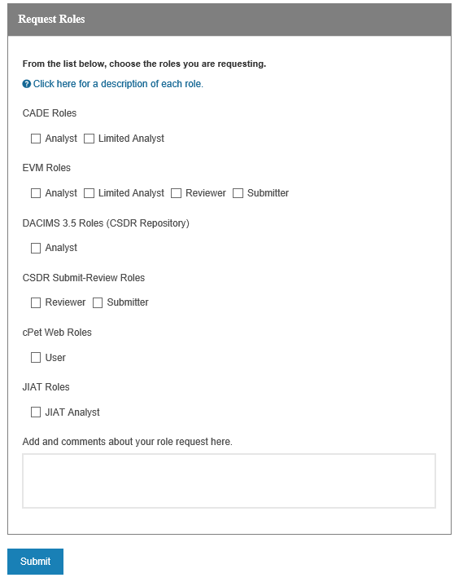
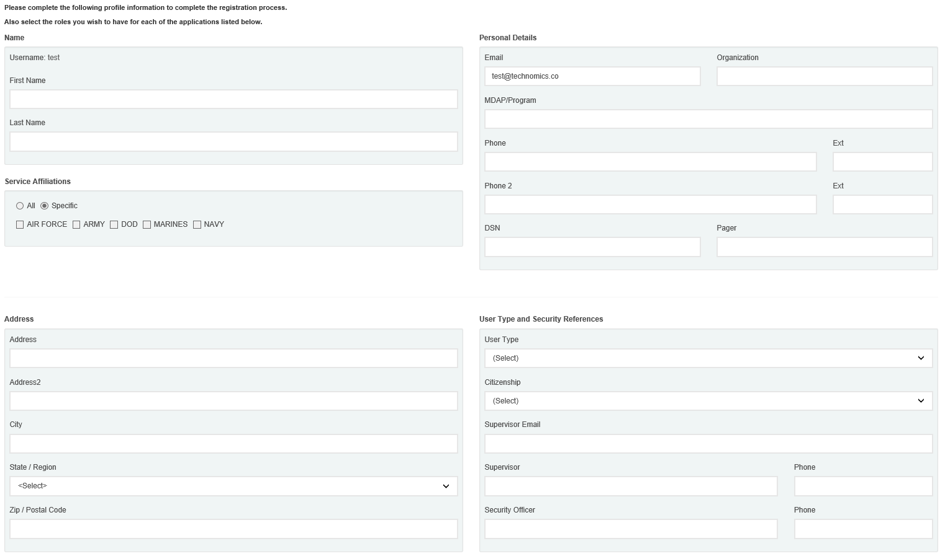
Account Registration
Create a username and password, enter your email address, and click submit
When completing the account request form, request the “CSDR-SR Role” role
Select your desired roles
Click “Submit” to begin account approval process

Slide 8
Logging into the Submit-Review Application

Slide 9
Integrated User Dashboard
You will now have the capability to customize your dashboard with status updates, data and information from all of the applications available to you
News about future design releases, training classes, new policies and site maintenance will appear as a default tile.
The “Dashboard Help” Menu explains how to add, modify and delete the different tiles of information.

Slide 10
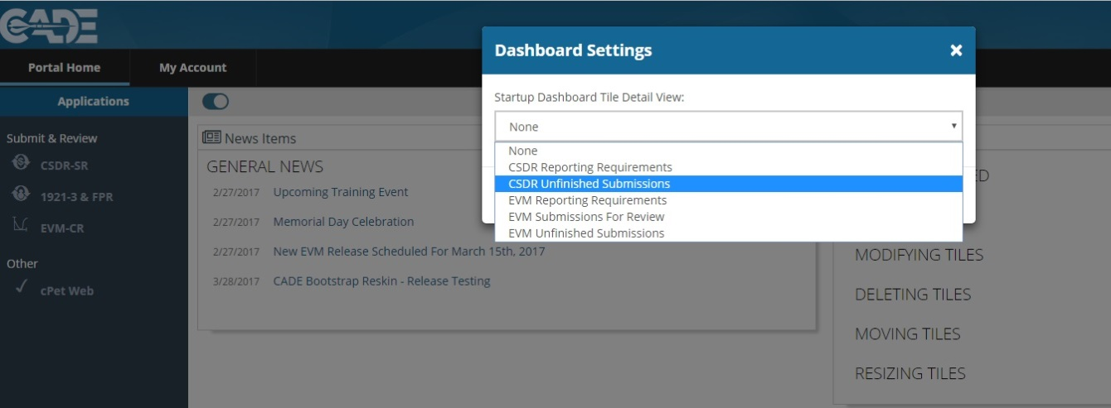
Integrated User Dashboard
Select the icon to expand the list of dashboard tiles.
You can select to display upcoming reporting requirements or current submissions in progress that you are currently working to complete
If you are a Submitter for both the EVM-CR and CSDR-SR, you can now see BOTH CSDR and EVM reporting requirements and submissions in progress on your dashboard

Slide 11
Integrated User Dashboard
Selecting the icon will close the detailed view of the tiles and return to your dashboard.
Selecting View Details on any tile will expand the tile to display more information.
See in CSDR" to transition to "Upload Home" within the CSDR-SR Application.

Slide 12
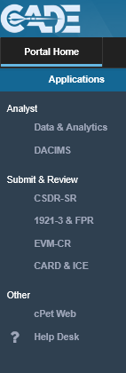
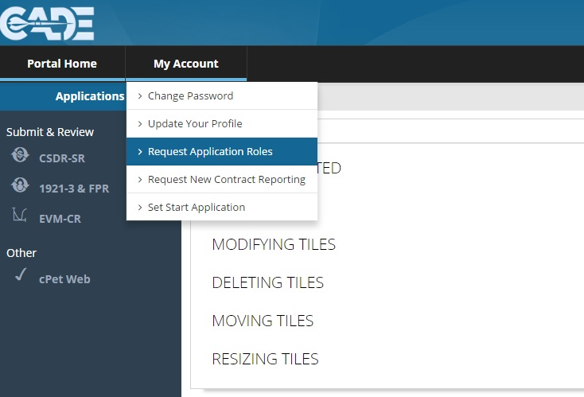
Logging into CSDR-SR System
After logging in, select the CSDR-SR link
If you do not have this link, you will need to request access
Select “Request Application Roles” from “My Account” drop down to request CSDR-SR Submitter role
Select the “CSDR-SR” link
Select “Request Application Roles”

Slide 13
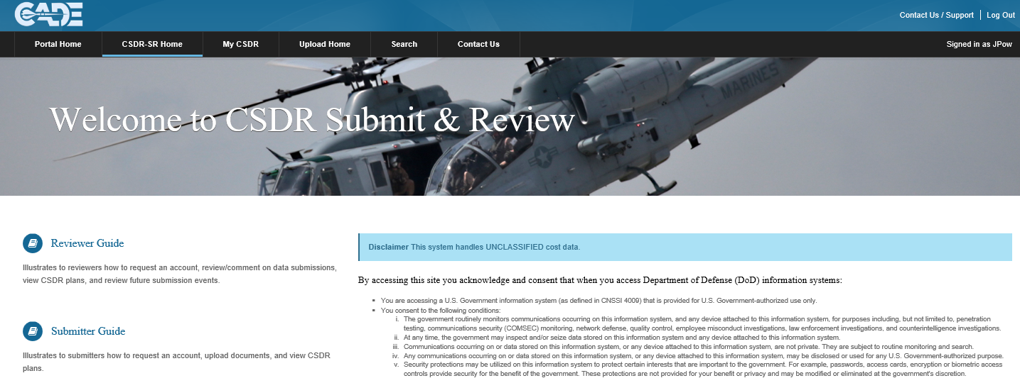
Logging into CSDR-SR System
Select the Upload Home tab to continue:
Select “Upload Home” to access submissions

Slide 14
Requesting Contract Access

Slide 15
Upload Home: Contract Request
The “Contract Request” tab allows a Submitter to enter the Prime Contract Number or CSDR Plan Number
Clicking “Send Request” will alert the DCARC Validation Analysts that you need to be added to the contract:
Enter the Contract Number or Plan Number and select “Send Request”

Slide 16
Upload Home Overview

Slide 17
Upload Home: Submission Events
On the “Upload Home” page, select the “Upload” option on the right side of the table to begin uploading files for a given submission event
If you have submissions due within the next 60 days that are not showing up, please contact the Program Office Reviewer from your government Program Office
Select “Upload” to begin the submission process

Slide 18
Upload Home: Assigned Contracts
The “Assigned Contracts” tab shows the Submitter which contracts they are assigned to in the Submit-Review website
If a contract that you are required to submit reports for is not listed here, click on the “Contract Request” tab:
Click on the Prime Contract Number for more information about the contract, approved plans, and submission events

Slide 19
Upload Home: Submissions in Progress
The “Submissions in Progress” tab displays the submissions that have either been started, but not submitted, or submissions that have been set back to “In Process: Contractor” by the DCARC Validation Analyst:
Click “Upload” to continue a submission

Slide 20
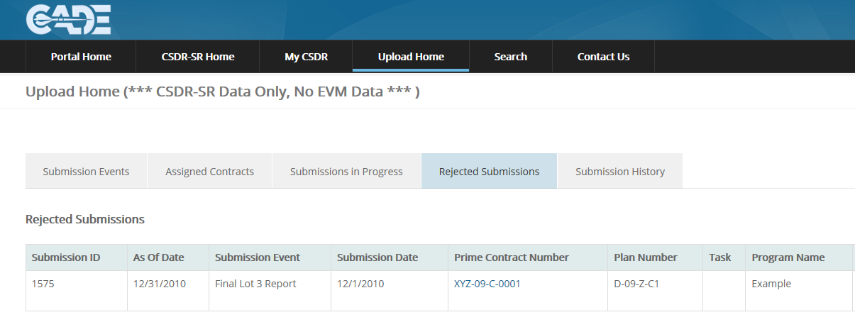
Upload Home: Rejected Submissions
The “Rejected Submissions” tab displays a record of the submissions that have been formally rejected by the Director of the DCARC:

Slide 21
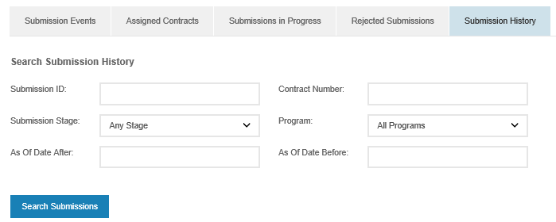
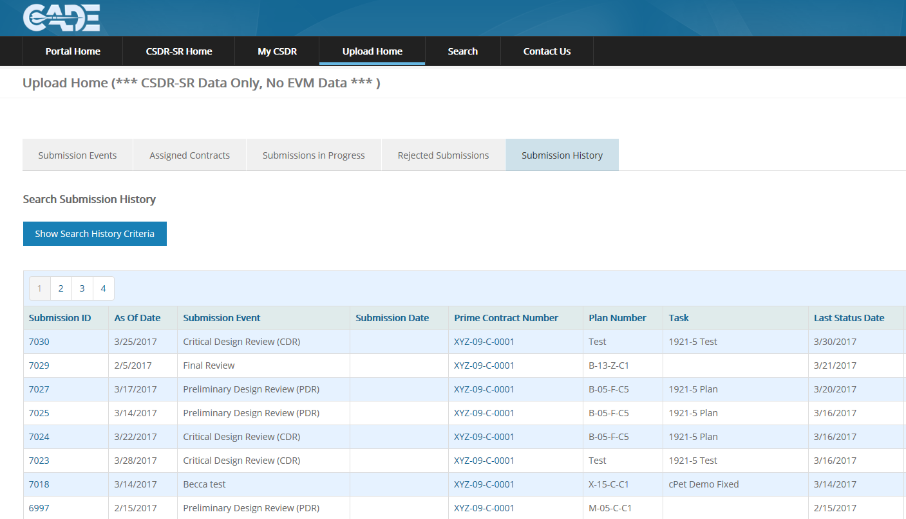
Upload Home: Submission History
The “Submission History” tab displays a historical record of all submissions, in all stages, for the history of the Submitter:
Enter Search criteria to locate a specific submission or set of submissions
Click on the Submission ID # to see the details of the historical submission

Slide 22
XML Conversion Instructions

Slide 23
cPet Overview
Key cPet Functions
Build & Edit CSDR Plans and RDT
Build, Edit, & Pre-validate CCDR Formats
Import and create Excel CCDR forms/templates
Import CCDR data from Excel “flat file”
cPet native file format is XML!

Slide 24
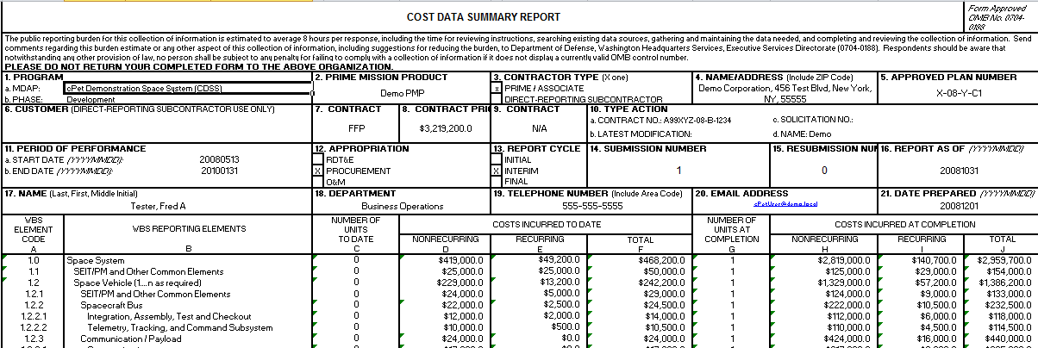
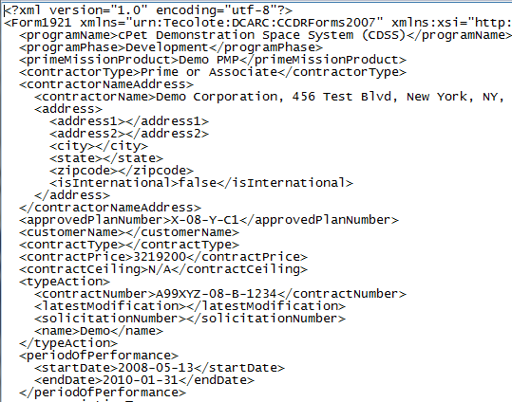
You’re Already Doing It
cPet defines XML standard for CCDR data

Slide 25
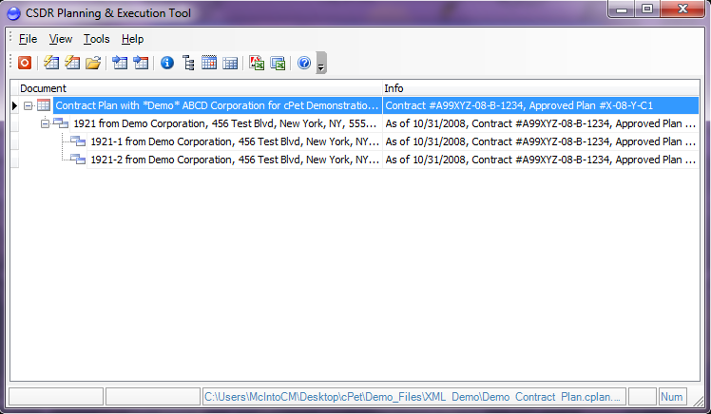
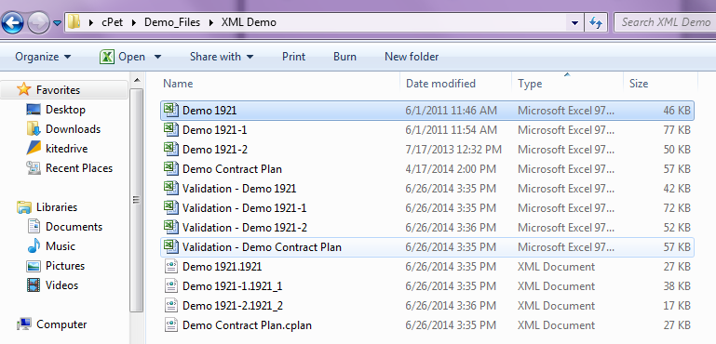
cPet Desktop Conversion
Import Excel version of the Contract Plan, then the Excel 1921, 1921-1, and 1921-2, or Excel Flat File
cPet automatically creates XML versions of the original Excel files in their source folder directory

Slide 26
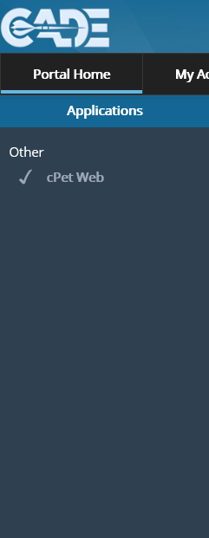
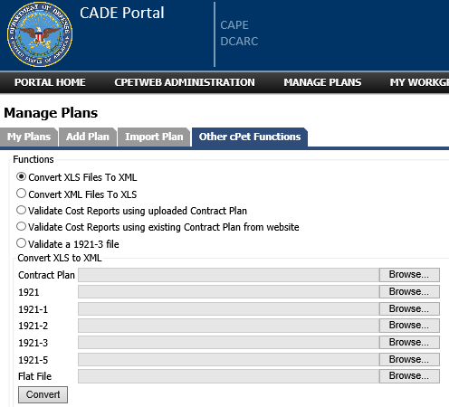
cPet Web Conversion
Navigate to cPet Web from the PORTAL HOME page, “MY CPET”, and “Other cPet Functions”
Browse and select the Excel Contract Plan, 1921, 1921-1, and 1921-2 reports. Then click “Convert”

Slide 27
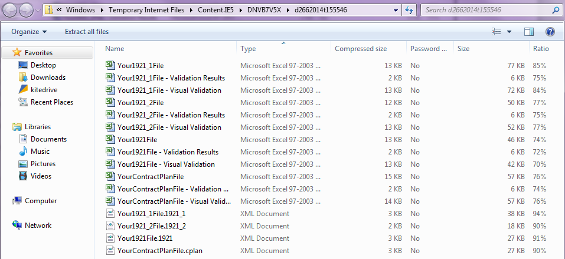
cPet Web Conversion, cont.
You will be prompted to “Open” a folder containing the original Excel files, as well as the converted XML files

Slide 28
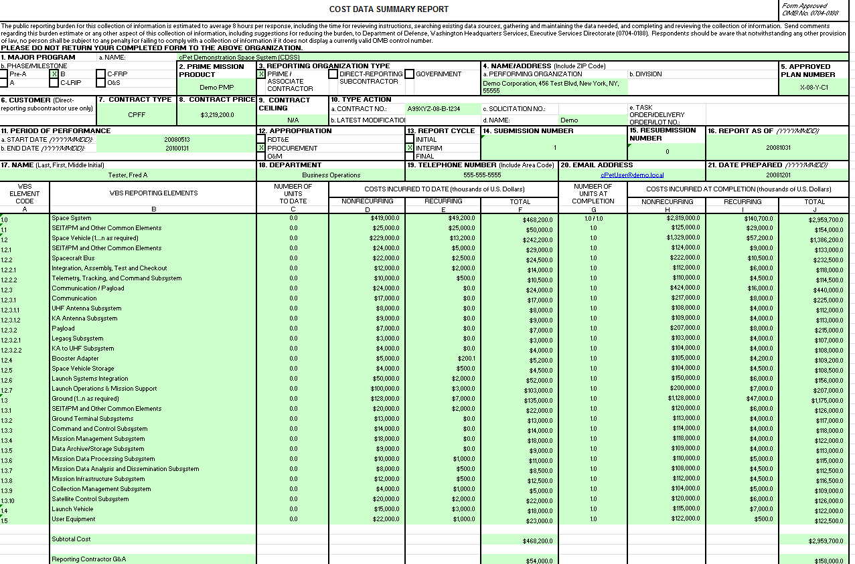
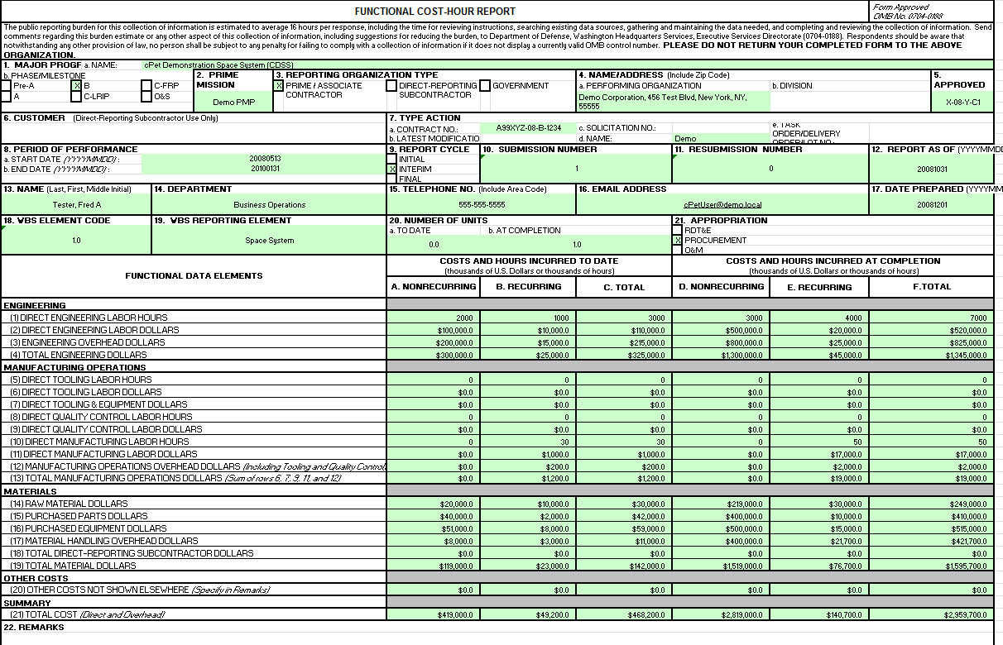
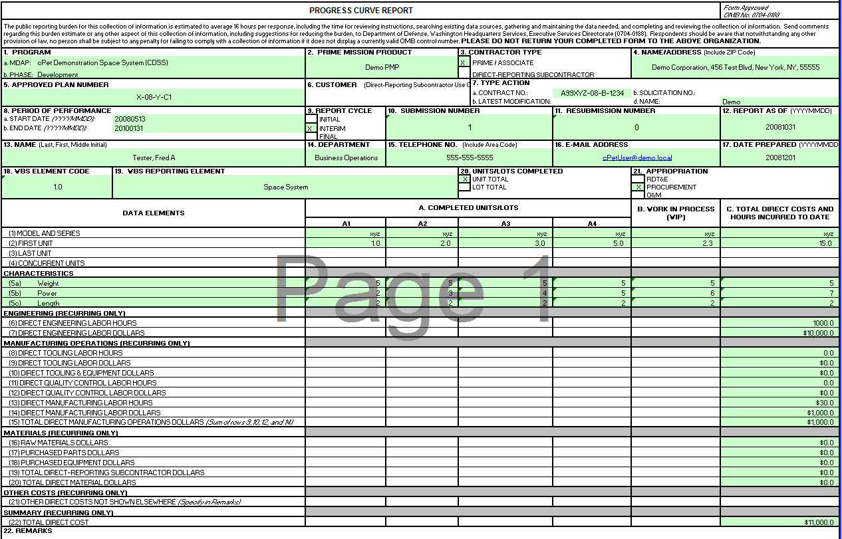
Visual Validation Files
cPet desktop and cPet Web create Excel “Visual Validation” files in the source folder containing the original files
Cells highlighted in GREEN verify that the Excel data was transferred correctly to XML, and the data will be readable in XML format
Only the first 1921-1 and 1921-2 report will have the header information highlighted in GREEN

Slide 29
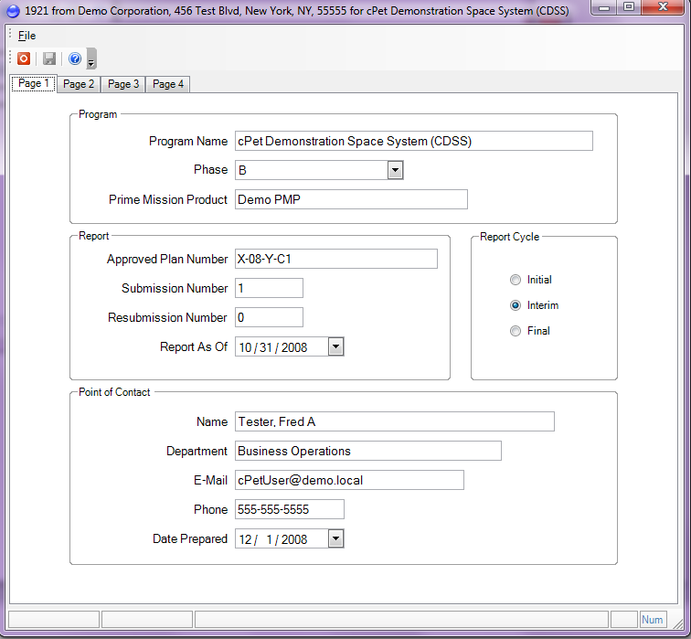
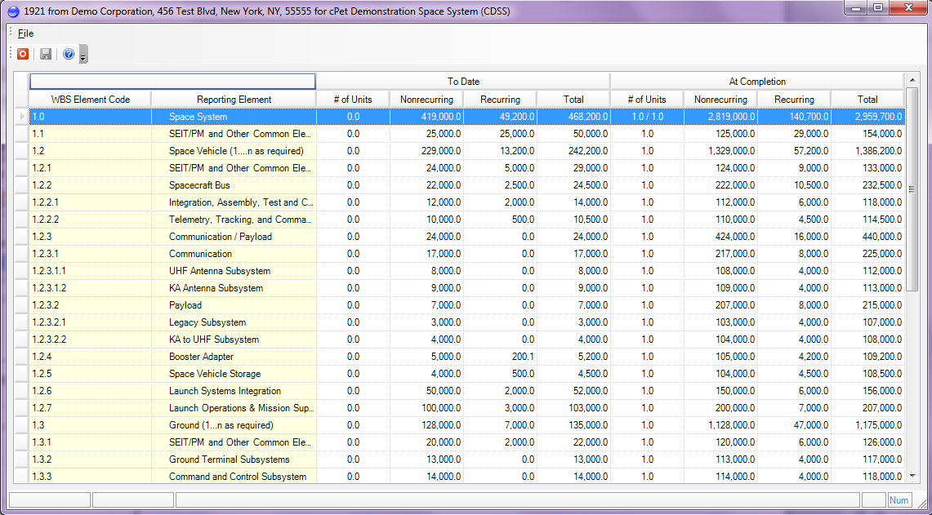
Troubleshooting
If the “Visual Validation” files contain cells that are not highlighted in GREEN, the files can be corrected within cPet Desktop:
Edit and Save Header Information
Edit and Save Cost Data

Slide 30
Submitting Cost Reports

Slide 31
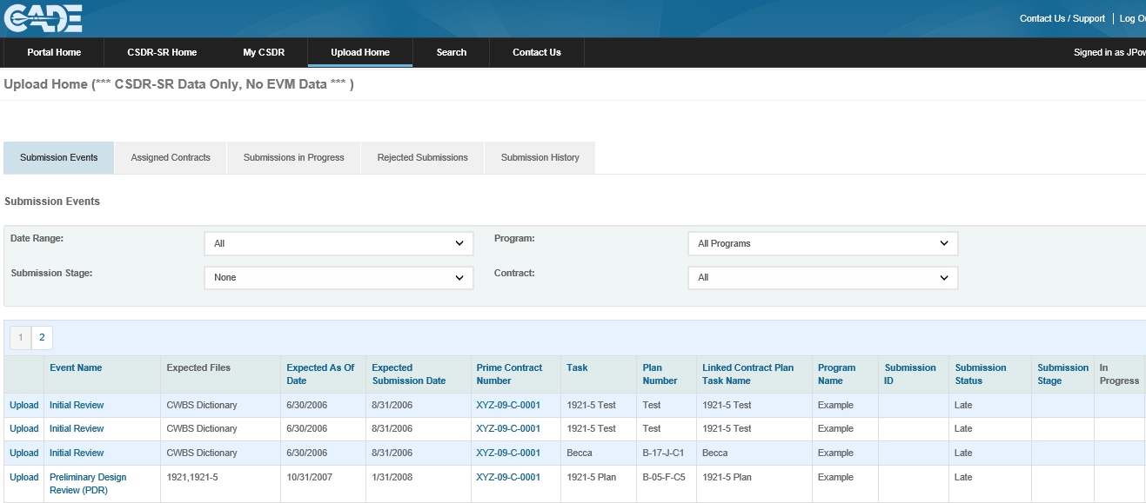
Step 1: Select Submission Event
Access the CSDR Submit-Review Application via the CADE Portal Home Page, then navigate to Upload Home
Identify the Submission Event and click “Upload” to begin the submission
Select “Upload” to begin the submission process

Slide 32
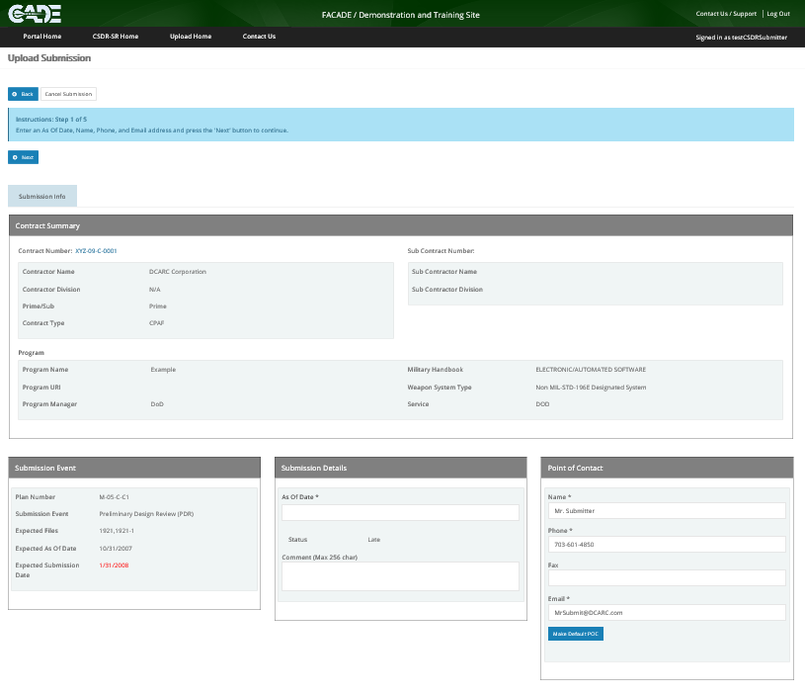
Step 2: Enter As Of Date
The Submitter will enter the report ‘As of Date’ from all CSDR reports
Once the POC Information has been verified, select “Next” to continue
Select “Next” to continue
Submitter enters the ‘As of Date’

Slide 33
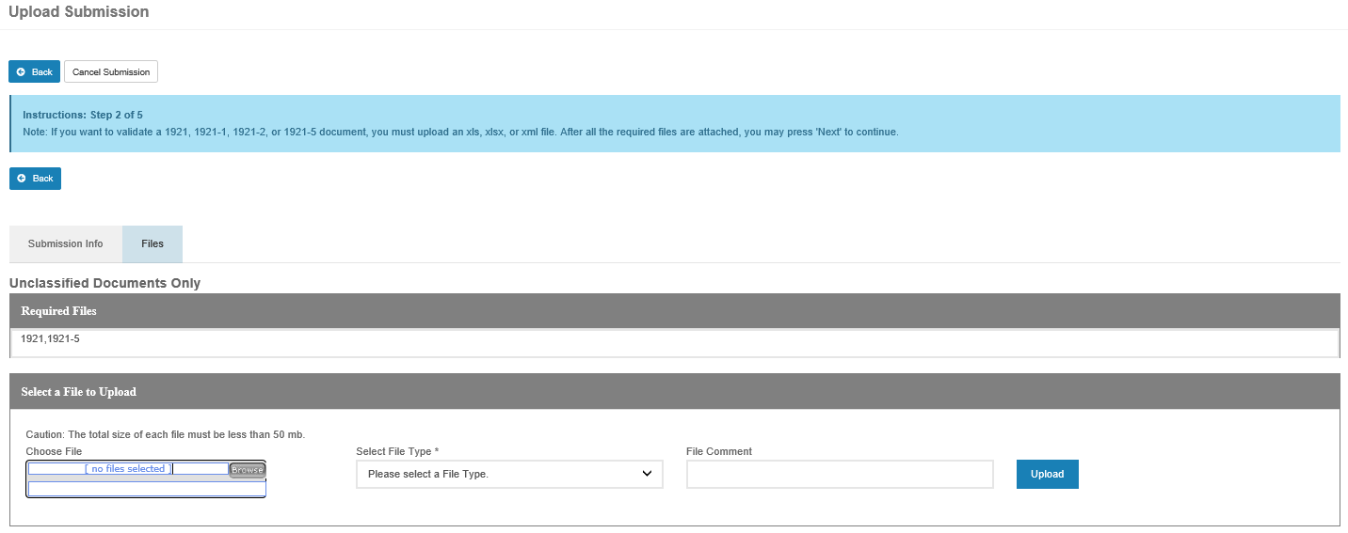
Step 3: Browse, Select, Upload Files
To upload the Excel and XML cost report files, select “Browse” to locate the report, select the correct “File Type”, and click “Upload”
Click “Next” to continue
Select “Browse” to locate files
Identify and tag the “File Type”
Select “Upload” to add the file

Slide 34
Step 3: Browse, Select, Upload Files
Now all sets of 1921 data will be required to be validated against the approved CSDR Plan prior to finalizing the submission
Notice multiple variants of data can be uploaded

Slide 35
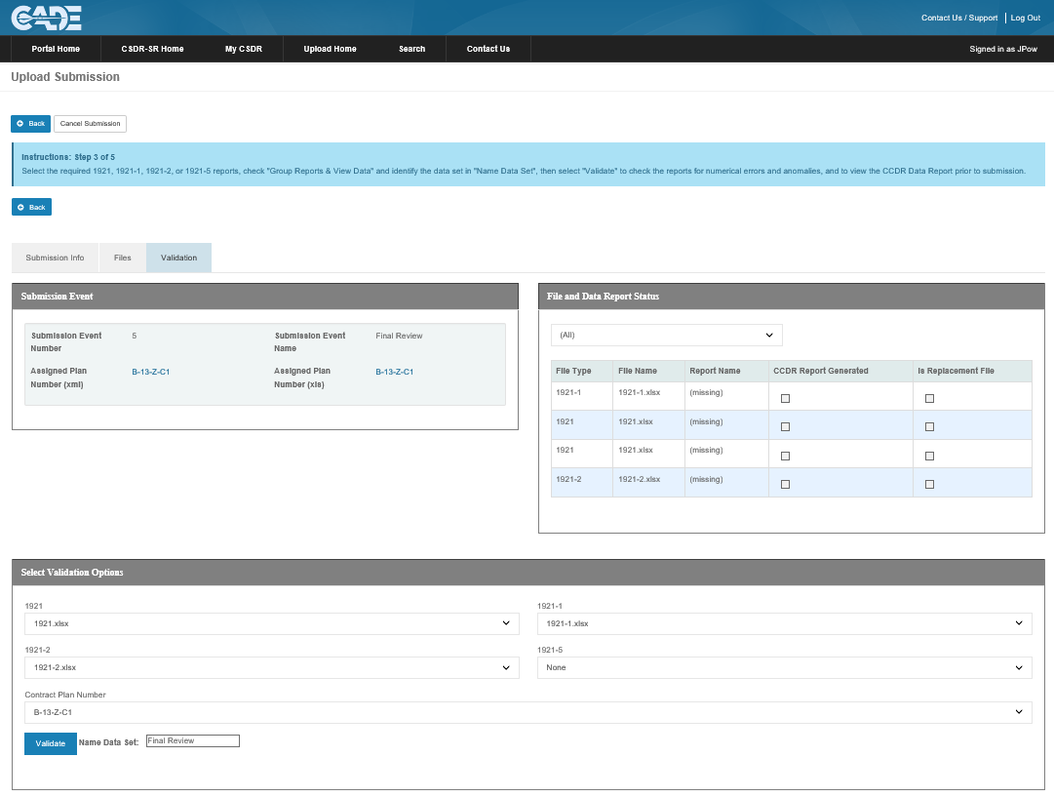
Step 4: Name Data Set & Validate
Submitters must validate and generate CCDR Data Report prior to submitting reports
If the submission event requires multiple sets of 1921, 1921-1/5, and 1921-2 reports, a CCDR Report must be validated and generated for each data set. For example, the report names could be: “Variant 1” and “Variant 2”
Submitters are NOT required to validate CWBS Dictionaries or Software Reports (SRDRs). When uploading these files, Click “Next” to continue
Submitter ensures that the correct files are listed in the drop-down menus
Submitter enters the name of the submission for “Name Data Set”, then clicks “Validate”

Slide 36
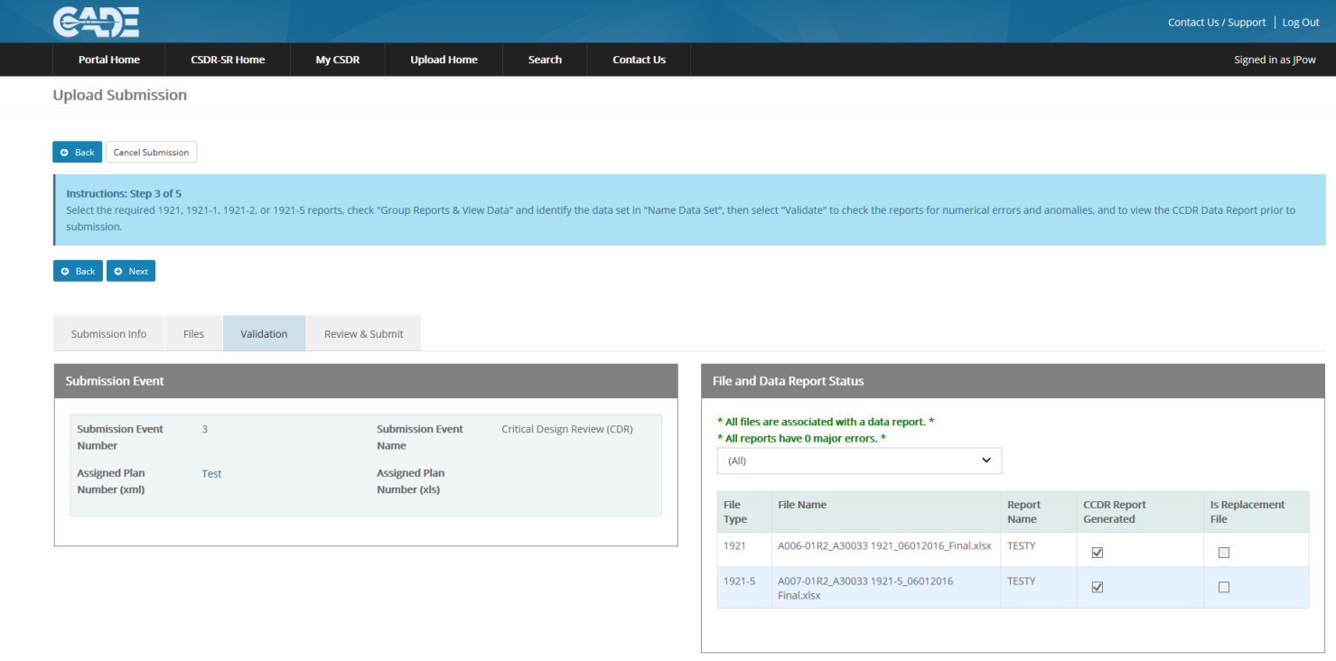
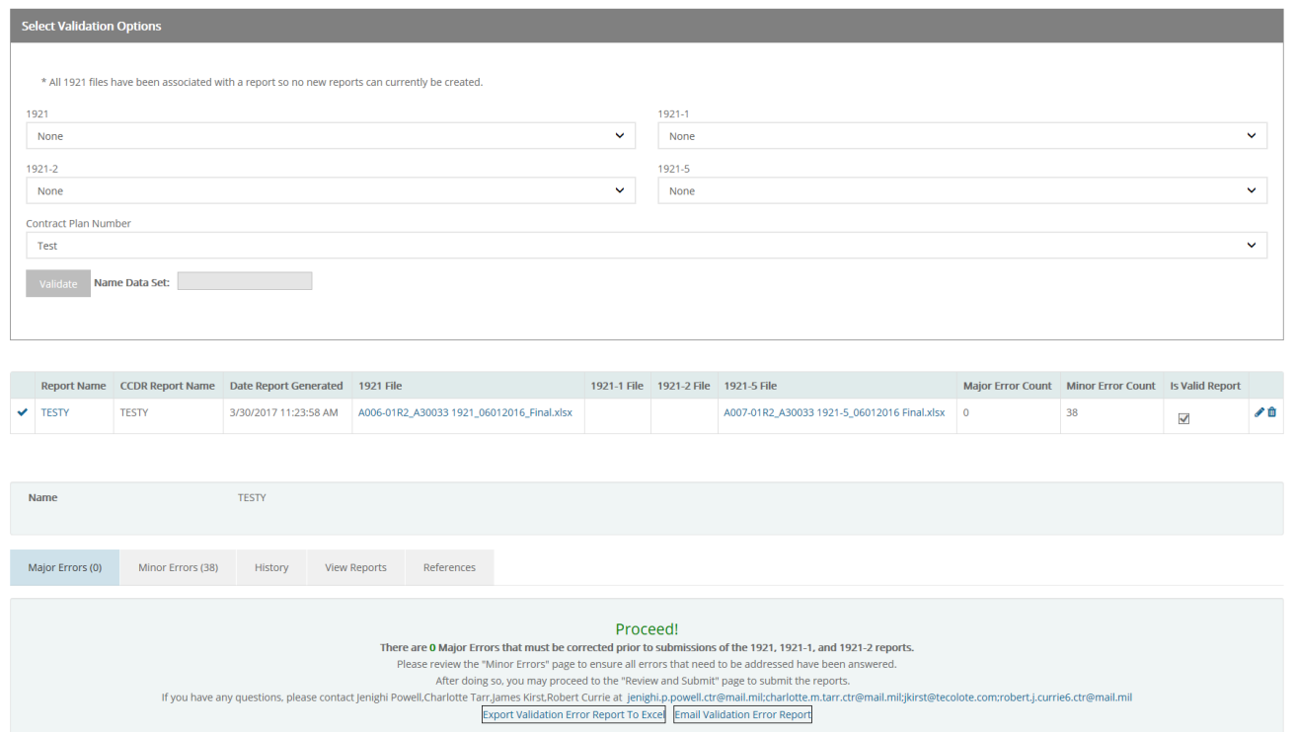
Step 4: Name Data Set & Validate
ALL files must be associated with a data report and have no major errors in order to proceed to Step 5

Slide 37
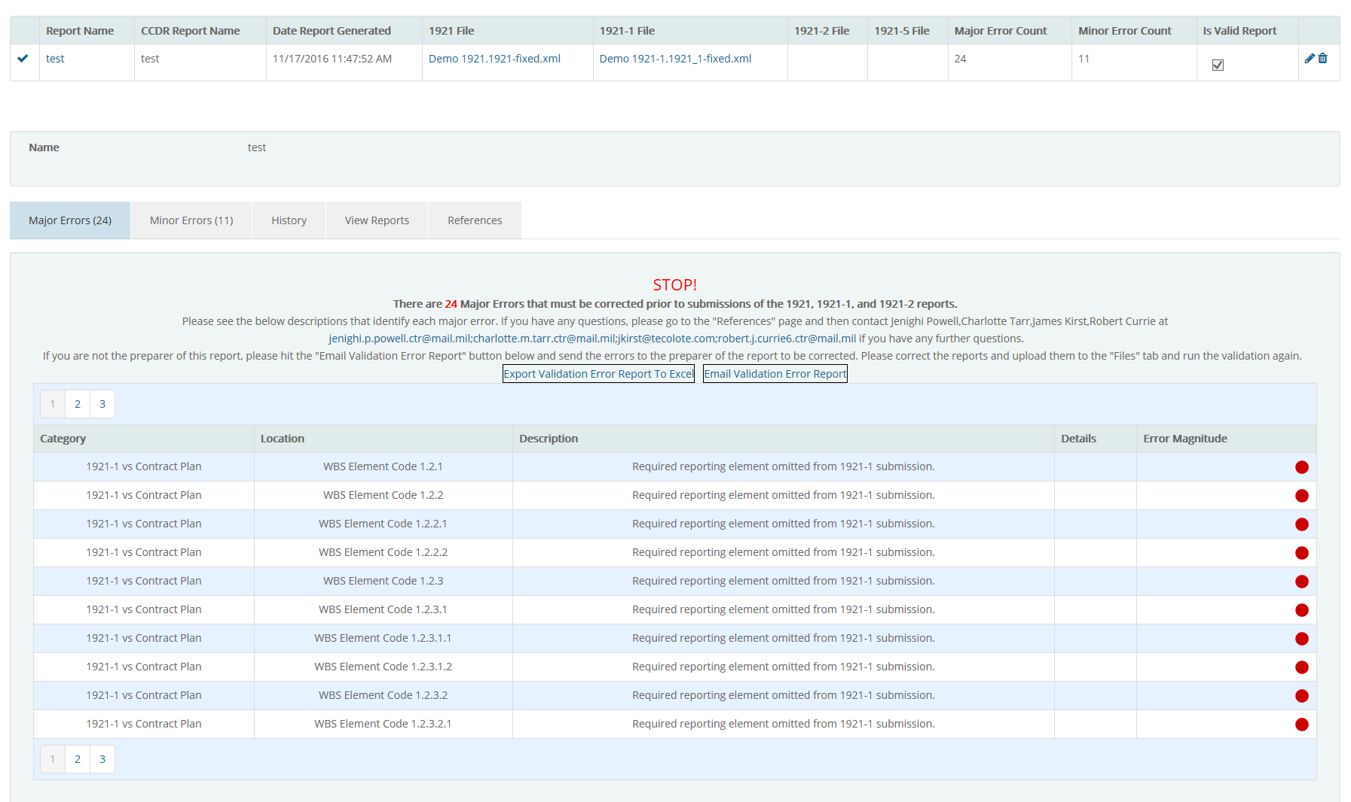
Step 5: Review Major Errors
The cPet Validation Error Report is displayed on the Validation screen
ALL identified Major errors MUST be corrected in order to proceed to the next step in the upload process
The DCARC POC’s are listed for you to contact with questions
Submitters have the option to Export the Error Report to Excel, or Email Validation Error Report to another user

Slide 38
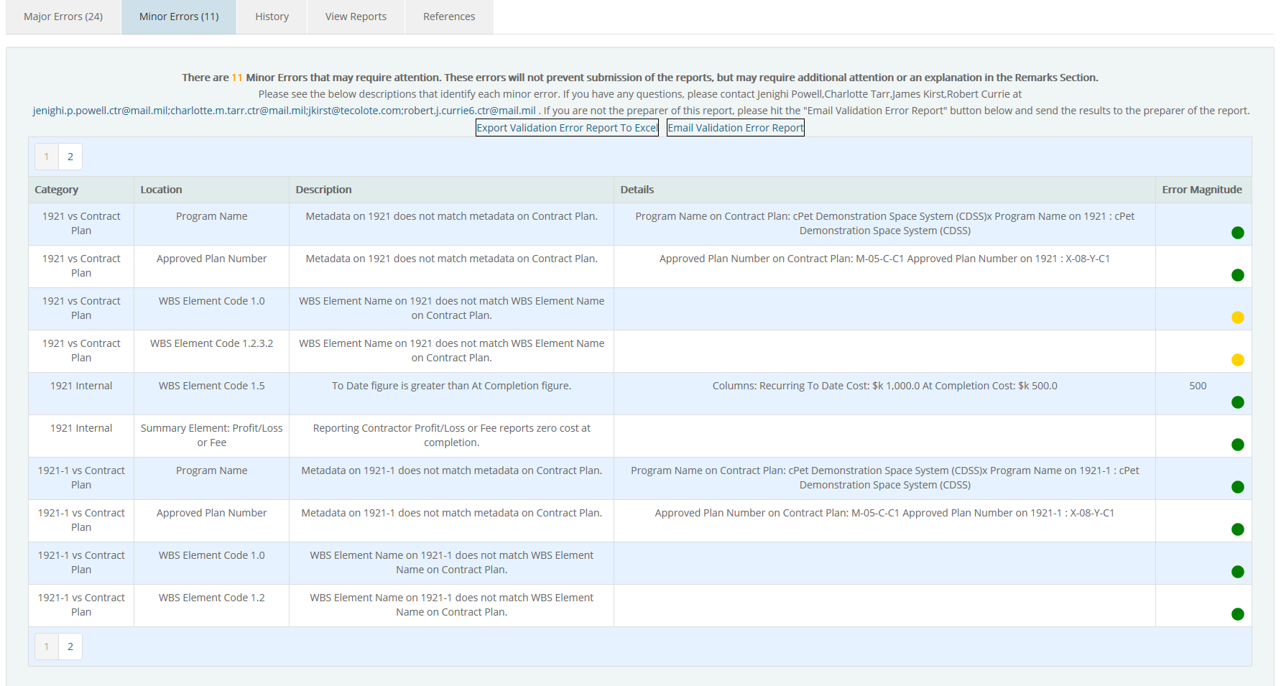
Step 6: Review Minor Errors
The cPet Validation Error Report also displays Minor errors, or errors that require additional comments in the Remarks section
Minor Errors displayed on the Validation tab will NOT prevent the submission from being submitted

Slide 39
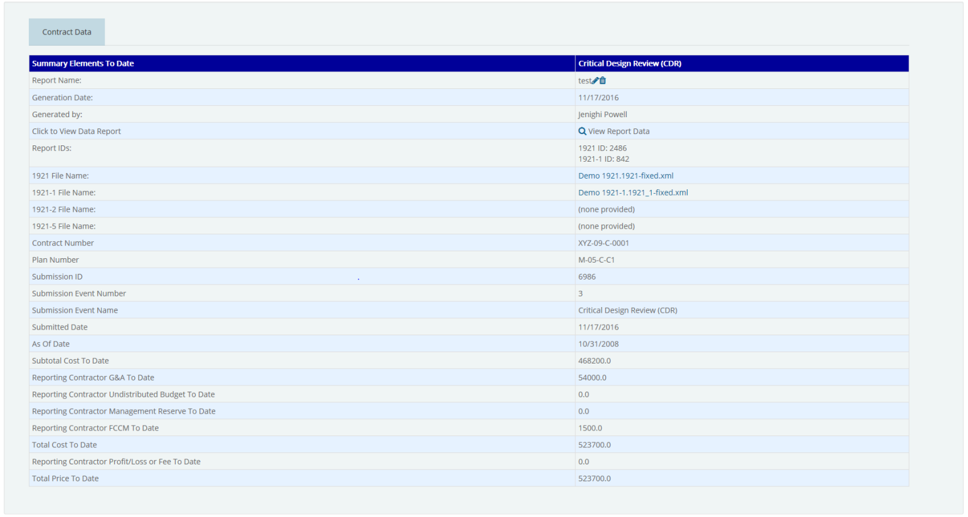
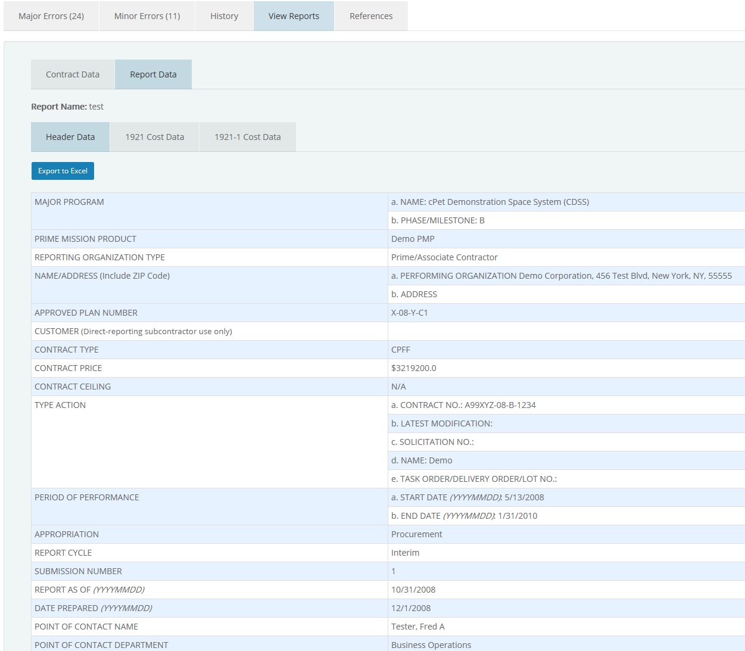
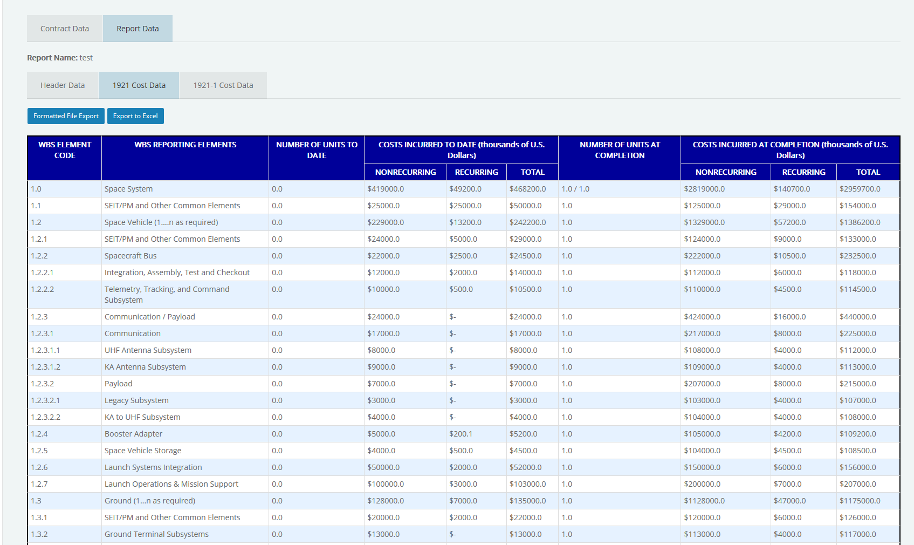
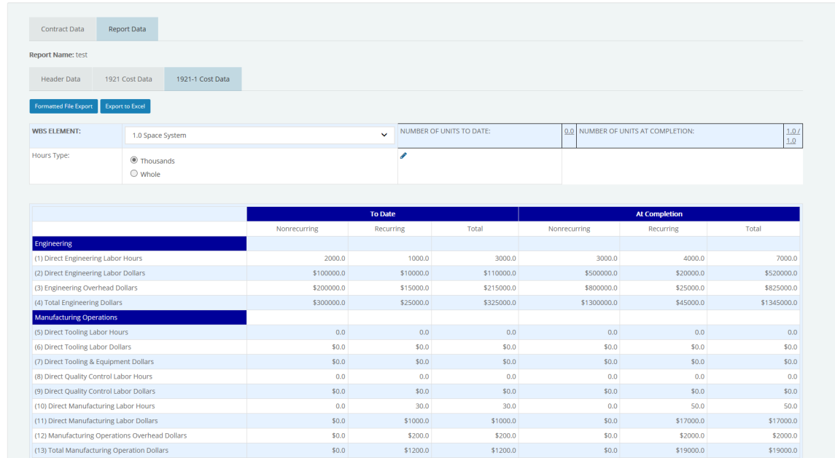
Step 7: Review Data Reports
The Submitter should review the cost data under “View Reports” to check for missing or incorrect data
Click to view the Data Reports for the 1921, 1921-1/5, 1921-2

Slide 40
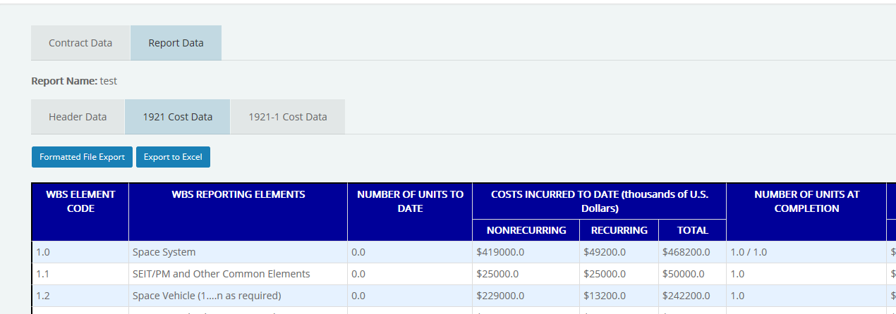
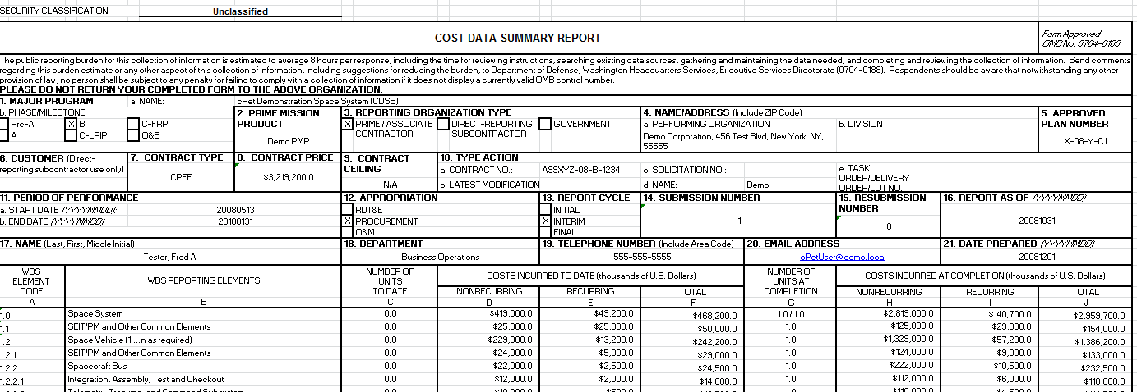
Step 7: Review Data Reports
The Formatted File Export allows you to download the XML data in the human-readable Excel format
ALL 1921,-1,-2 files are REQUIRED to be submitted in the XML format solely

Slide 41
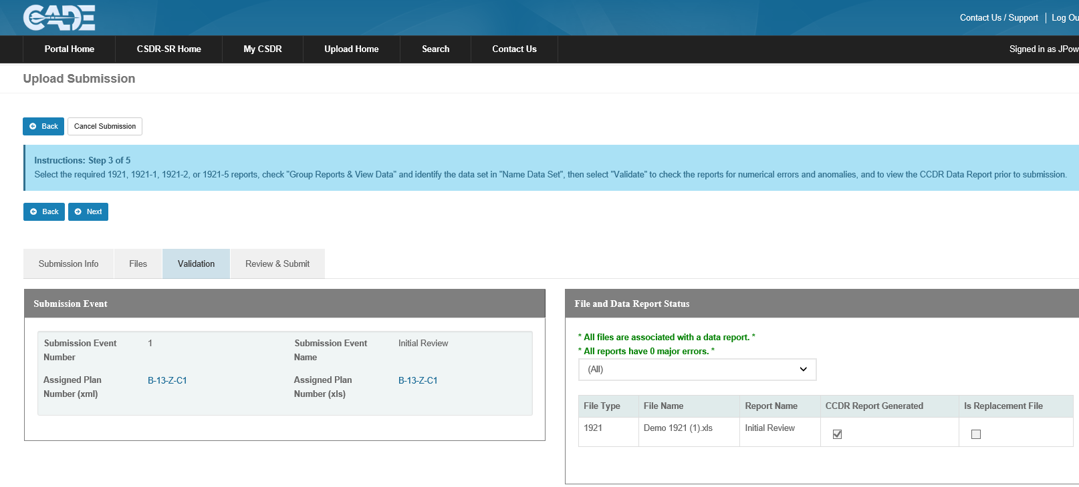
Step 8: Proceed with No Major Errors
Steps 1 – 7 should be repeated until there are no Major errors identified and the Validation Error Report allows you to “Proceed” to the next step, and click “Next” located at the top of the page
If you leave the Submit-Review application, the started submission will be found under “Submissions in Progress”
Click “Next” to proceed to the “Review & Submit” tab

Slide 42
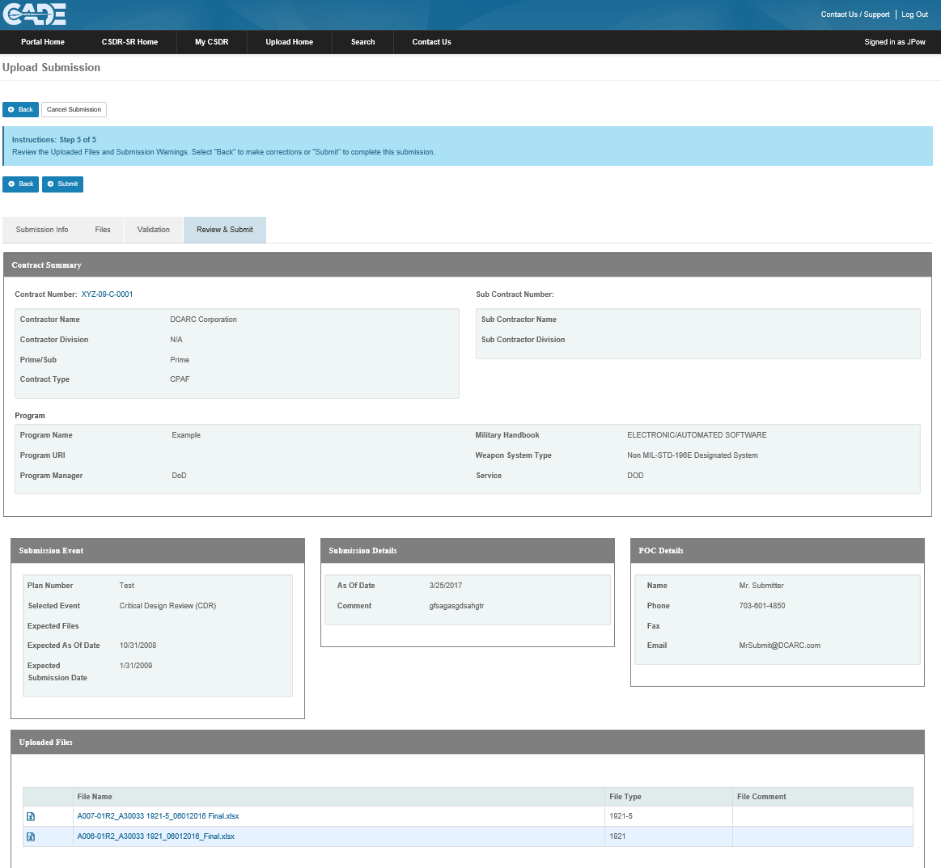
Step 9: Review and Submit
Once the 1921, 1921-1/5, and 1921-2 reports have been validated with NO MAJOR ERRORS, the CCDR Data Report has been generated, and the Submitter has reviewed their Data Report, click “Submit” to finalize the submission
CWBS Dictionaries and SRDR reports do not have to be validated; therefore, can move from the “upload files” tab to the “Review & Submit” tab
The Submitter will receive an automatic email confirmation from the system as soon as their reports have been submitted
Click “Submit” to finalize the submission

Slide 43
Viewing CSDR Plans

Slide 44
Viewing CSDR Plans
To access the CSDR plans the DCARC has on file for your contracts you must access the Contract Detail screen for each contract
You can access the Contract Detail screen by clicking on the contract number hyperlink on the “Assigned Contracts” tab on the Upload Home page:
Click on the Prime Contract Number to view the Contract Details

Slide 45
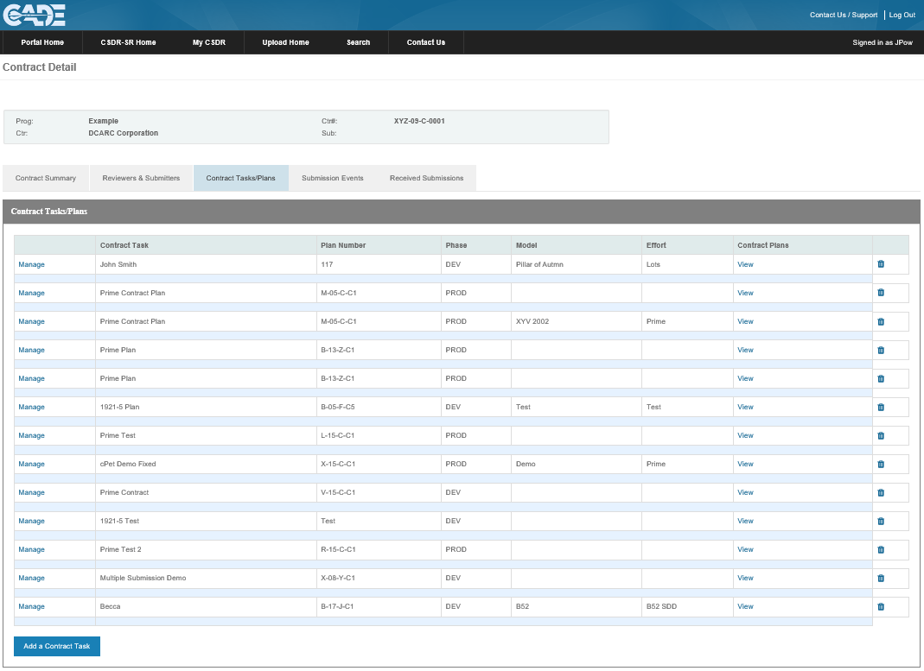
Viewing CSDR Plans
From the Contract Detail screen select the “Contract Tasks/Plans” tab:
Click on the “Contract Tasks/Plans” tab

Slide 46
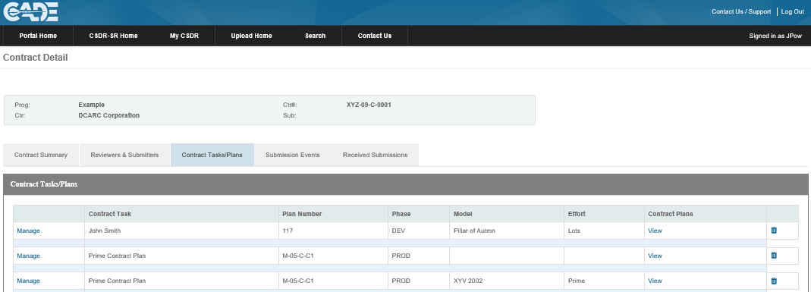
Viewing CSDR Plans
Selecting “View” will allow you to access both the XML and Excel version of the CSDR plans that are currently on file:
Click “View” to download the XML and Excel versions of the approved CSDR Plan

Slide 47
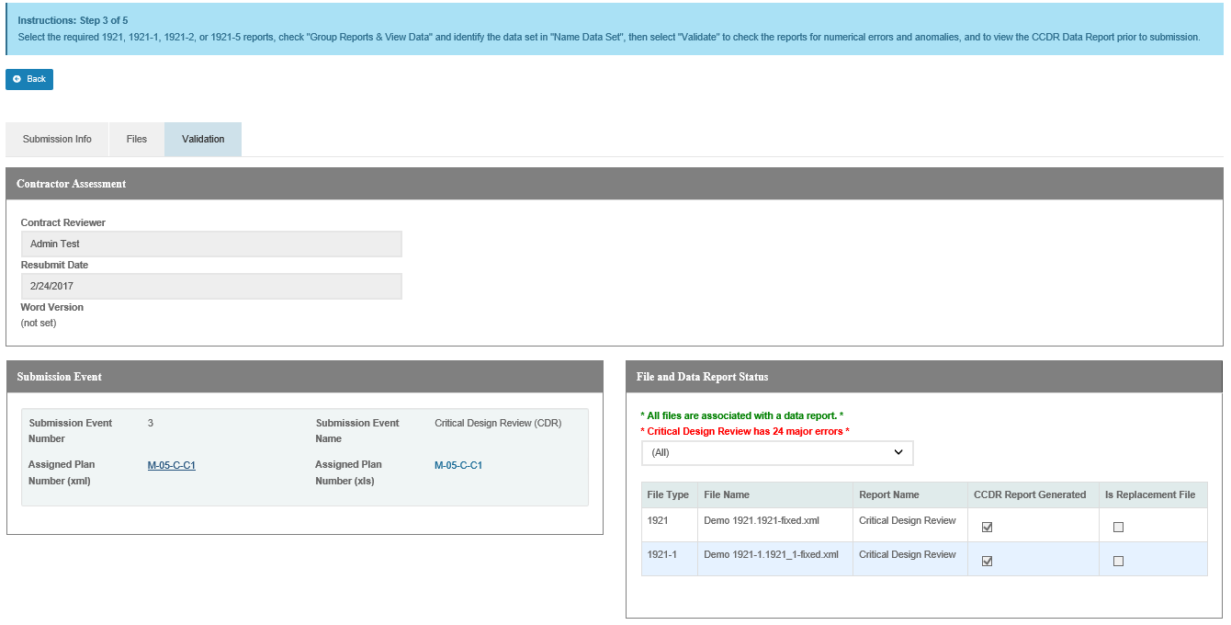
Viewing CSDR Plans
The Excel and XML versions of the approved CSDR Plan can also be viewed and downloaded during Step 3 of the submission process:
Click on the Plan Number to view/download the Excel and XML versions of the plan

